Slide 1
Digital Marketing Project Work
Project Title: Comprehension Digital Marketing For Hyundai Motor Company
Name: Gopisetty Pavithra
Team ID: LTVIP2025MID25263

Slide 2
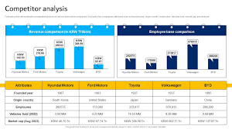
Comprehension digital Marketing For Hyundai Motor Company
Brand study, competitor Analysis & Buyer’s/Audience persona Hyundai Motor Company, a global automotive giant, aims for "Modern Premium" positioning, focusing on value, comfort, and technology for its target audience of middle to upper-income professionals and young.

Slide 3
Research Brand Analysis
Hyundai Motor Company's brand identity revolves around "Modern Premium" and "Progress for Humanity," aiming to deliver new experiences and values to consumers, emphasizing innovation, sustainability, and a people-first approach.
Competitor Analysis
Hyundai Motor Company faces competition from global giants like Volkswagen, Toyota, General Motors, and Ford, as well as regional players like Maruti Suzuki and Tata Motors, with each company vying for market share through diverse strategies and product offerings.
Buyer’s /Audiencce”s Persona
Hyundai's target audience, or buyer persona, is generally career-oriented, upwardly mobile consumers who seek a blend of style, reliability, and value, often with a focus on modern premium features and a positive customer experience.
SEO & Keyword Research
For Hyundai Motor Company's SEO and keyword research, focus on keywords related to their core offerings (vehicles, technology, and future mobility), their brand positioning (modern premium), and specific models like IONIQ 5, IONIQ 6, and SANTA FE.

Slide 4
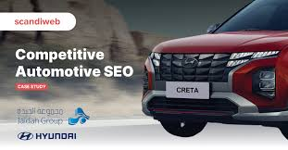
SEO Addict
To perform an SEO audit for Hyundai Motor Company, focus on website structure, content optimization, keyword research, technical SEO, and link building strategies, while also considering local SEO and customer experience.

Slide 5
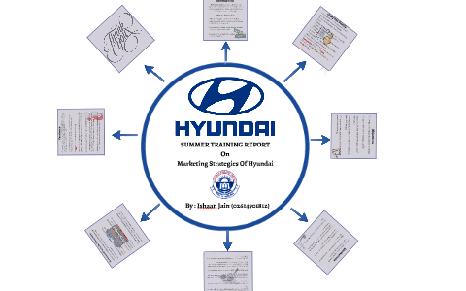
Keyword research For keyword research about Hyundai Motor Company, focus on terms related to Hyundai's products (e.g., specific models), technology (e.g., EVs, hydrogen), and its global presence (e.g., India, global expansion). On Page Optimization Hyundai Motor Company, a global automotive leader, aims to optimize its on-page content and website structure for better user experience and search engine visibility, focusing on areas like keyword research, internal linking, and information architecture. Content Ideas And Marketing Strategires
For Hyundai Motor Company, focus on content showcasing their "Smart Mobility Solution Provider" vision, highlighting EV models like the locally produced electric SUV, and emphasizing their commitment to a new hydrogen business, while also targeting middle to upper-income professionals and corporates.

Slide 6
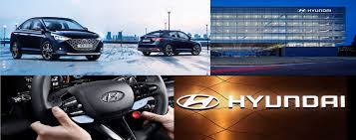
Content Idea Generation & Strategy Hyundai Motor is making significant strides in its quest to become a global top-tier player in the EV market. By 2030, Hyundai Motor aims to add 1 million units of production capacity to sell 5.55 million vehicles globally. The company plans to lead the automotive industry. Marketing Strategies Hyundai Motor Company's marketing strategies, particularly in India, focus on differentiated marketing, targeting middle to upper-income professionals and young consumers, and tailoring offerings to specific regional needs. They also emphasize a customer-centric approach, aiming to provide quality time and transition into a smart mobility solution provider.
Content Creation And Curation

Slide 7
To assist with the launch of the new incentive and engagement programme. Momentum has developed a private Facebook Group. With the aim of facilitating light-hearted engagement between dealership employees. This is an alternate way of looking at Facebook for Business. However, the concept is fairly simple; ensuring Hyundai employees habitually visit the group and engage with the information to redeem rewards and training.
Post Creation
Hyundai Motor Company, founded in 1967 by Chung Ju-yung, has evolved from a Korean automotive pioneer to a global leader, known for its innovation and "Progress for Humanity" vision, including the development of the Pony and advancements in hydrogen fuel cell technology.
Designs/Video Editing
Instead of maintaining a consistent family look across the (entire) lineup, we offer a variety of designs that cater to customers' unique lifestyles and preferences, similar to the diverse chess pieces on a chessboard. Hyundai cars may vary in appearance, but design details like pixel lights present them as a cohesive group while maintaining their individual roles and personalities.

Slide 8

Social Media Ad Campaigns Instead of maintaining a consistent family look across the (entire) lineup, we offer a variety of designs that cater to customers' unique lifestyles and preferences, similar to the diverse chess pieces on a chessboard. Email Ad Campaigns Hyundai Motor Company uses diverse email ad campaigns, including those focused on new vehicle launches, customer service, sustainability, and brand awareness, often leveraging AI and highlighting their "Progress for Humanity" vision. https://youtu.be/p3ACp_GlJCI?si=YtFkRN-wr9dD5nJe
I wanted to thank you for being a speaker at [eventName]. Your presentation on [topic] was received very well by our audience. Many attendees also mentioned that it was one of the highlights of the event. To give you an idea of the feedback we received, I have compiled some of the attendee feedback here

